Slide 1
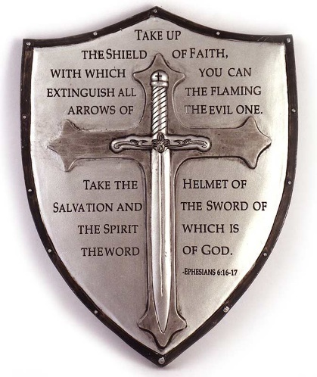
Faith Review
Faith 101 - Faith Part 1
Know your Enemy – Faith Part 2
Powerful Acts of Faith - Part 3A
Powerful Acts of Faith - Part 3B
Powerful Acts of Faith - Part 3C
A Refuge City Church
Bible - Study
https://www.mathcompiler3d.com/bible-study

Slide 2
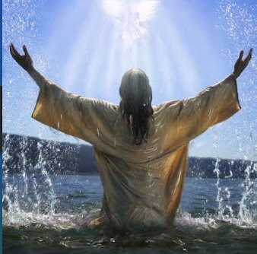
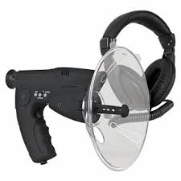
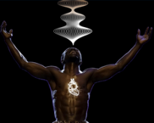
Faith 101: The Basics of Faith
Why do we need faith?
Hebrews 11:6
But without faith it is impossible to please him: for he that cometh to God must believe that he is, and that he is a rewarder of them that diligently seek him.
What is Faith?
Hebrews 11:1
Now faith is the substance of things hoped for, the evidence of things not seen.
How does Faith come?
Romans 10:17
So then faith cometh by hearing, and hearing by the word of God.
How is Faith released?
Mark 11:23
For verily I say unto you, That whosoever shall say unto this mountain, Be thou removed, and be thou cast into the sea; and shall not doubt in his heart, but shall believe that those things which he saith shall come to pass; he shall have whatsoever he saith.

Slide 3
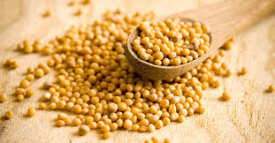
Faith 101: The Basics of Faith
Do all men have Faith?
Romans 12:3 – God has given to every man the man of faith
For I say, through the grace given unto me, to every man that is among you, not to think of himself more highly than he ought to think; but to think soberly, according as God hath dealt to every man the measure of faith.
2 Thessalonians 3:2 – Wicked and unreasonable men don’t have faith
And that we may be delivered from unreasonable and wicked men: for all men have not faith.
How much Faith do you need?
Matthew 17:20 – You only need a small amount, you speak it, and it grows
And Jesus said unto them, Because of your unbelief: for verily I say unto you, If ye have faith as a grain of mustard seed, ye shall say unto this mountain, Remove hence to yonder place; and it shall remove; and nothing shall be impossible unto you.

Slide 4
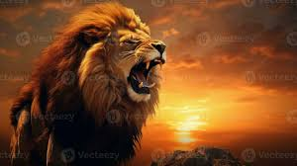
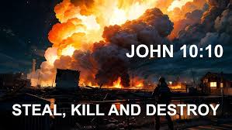
Know your Enemy
What is the primary tactic of your enemy?
1 Peter 5:8 – He walks about “As” a roaring lion – seeking – (Don’t be his prey)
Be sober, be vigilant; because your adversary the devil, as a roaring lion, walketh about, seeking whom he may devour:
What is the agenda of your enemy?
John 10:10 – Kill, Steal, Destroy
The thief cometh not, but for to steal, and to kill, and to destroy: I am come that they might have life, and that they might have it more abundantly.
Can you escape a temptation from your enemy?
1 Corinthians 10:13
There hath no temptation taken you but such as is common to man: but God is faithful, who will not suffer you to be tempted above that ye are able; but will with the temptation also make a way to escape, that ye may be able to bear it.

Slide 5
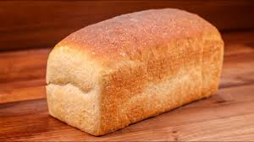
Know your Enemy
How do you fight an enemy you can’t see?
Hebrews 4:12 – Use the word of God, which is the sword of the spirit
For the word of God is quick, and powerful, and sharper than any twoedged sword, piercing even to the dividing asunder of soul and spirit, and of the joints and marrow, and is a discerner of the thoughts and intents of the heart.
How do we resist our enemy?
James 4:7 – Submit to God
Submit yourselves therefore to God. Resist the devil, and he will flee from you.
How do you submit to God?
By saying what God said, is his word, you come into agreement with him.
It is Written: Man shall not live by bread lone,
but by every word that proceeds out of the mouth of God
It is Written: Thou shalt worship the Lord thy God and him only shall thou serve
It is Written: Though shalt not tempt the Lord thy God
It is Written: God has not given us the Spirit of fear, but of power, love and a sound mind

Slide 6
Powerful Acts of Faith: Part 3A
Faith won’t work in an unforgiving heart
Mark 11:25
And when ye stand praying, forgive, if ye have ought against any: that your Father also which is in heaven may forgive you your trespasses.
Facts about Faith
Those who speak and act in Faith do so boldly
Jesus released Faith in every word he spoke: He always spoke the desired end result
David also spoke in faith and spoke the desired end result
David spoke with such authority, the unbelieving men of Israel took him to the king
David was not afraid of the giant! A lion, a bear? He shall be as one of these
David ran towards the giant – no fear in him whatsoever
God delivered Goliath into David’s hand because David used his faith
When the devil is stunned – take his head off

Slide 7
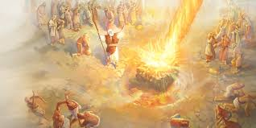
Powerful Acts of Faith: Part 3B
Have Faith like a prophet of God
Don’t flinch in the face of 450 evil prophets
Believe in what you can’t see, even if there are no rain clouds
Get down the mountain because there is an abundance of rain coming
Don’t be sore afraid
Speak boldly about God
God chose the foolish things of the world to confound the wise
Don’t accuse God of bringing you out in the wilderness to die
Faith never considers the circumstances but believes what the word of God says

Slide 8
Powerful Acts of Faith: Part 3C
What not to do when using Faith
Don’t take wine, strong drink, or any unclean thing when God is preparing you for his plan in your life
Don’t suddenly fear
Don’t sacrifice a goat to an angel or ask his name
Don’t play around with the devil – Riddles and women
Don’t believe in your own strength, but believe in God
When God gives you an extraordinary gift – don’t squander it!

