Slide 1
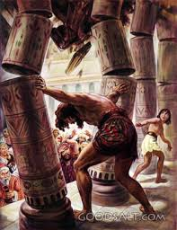
Powerful Acts of Faith
Faith
Part 3C
A Refuge City Church
Bible - Study
https://www.mathcompiler3d.com/bible-study

Slide 2
Samson
This is a story more about what not to do than what to do – yet Samson still made it into the hall of faith, barely, but he is still there. However, he did fight for Israel.
Hebrews 11:32 - And what shall I more say? for the time would fail me to tell of Gideon, and of Barak, and of Samson, and of Jephthae; of David also, and Samuel, and of the prophets:

Slide 3
Powerful Acts of Faith #1: 1 Kings 13:1-5
Israel does evil in the sight of the Lord – “Again”
For the mother
No-wine
No strong drink
No unclean thing
For the Child
No Razor
13 And the children of Israel did evil again in the sight of the Lord; and the Lord delivered them into the hand of the Philistines forty years.
² And there was a certain man of Zorah, of the family of the Danites, whose name was Manoah; and his wife was barren, and bare not.
³ And the angel of the Lord appeared unto the woman, and said unto her, Behold now, thou art barren, and bearest not: but thou shalt conceive, and bear a son.
⁴ Now therefore beware, I pray thee, and drink not wine nor strong drink, and eat not any unclean thing:
⁵ For, lo, thou shalt conceive, and bear a son; and no razor shall come on his head: for the child shall be a Nazarite unto God from the womb: and he shall begin to deliver Israel out of the hand of the Philistines.

Slide 4
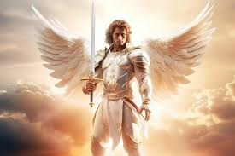
Powerful Acts of Faith #1: 1 Kings 13:6-10
Manoah asks the Lord
for help in raising his son
⁶ Then the woman came and told her husband, saying, A man of God came unto me, and his countenance was like the countenance of an angel of God, very terrible: but I asked him not whence he was, neither told he me his name:
⁷ But he said unto me, Behold, thou shalt conceive, and bear a son; and now drink no wine nor strong drink, neither eat any unclean thing: for the child shall be a Nazarite to God from the womb to the day of his death.
⁸ Then Manoah intreated the Lord, and said, O my Lord, let the man of God which thou didst send come again unto us, and teach us what we shall do unto the child that shall be born.
⁹ And God hearkened to the voice of Manoah; and the angel of God came again unto the woman as she sat in the field: but Manoah her husband was not with her.
¹⁰ And the woman made haste, and ran, and shewed her husband, and said unto him, Behold, the man hath appeared unto me, that came unto me the other day.

Slide 5
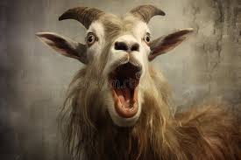
Powerful Acts of Faith #1: 1 Kings 13:11-15
For the mother – staying away from anything on the vine, wine or strong drink or an unclean thing was a condition of Samson’s strength – though this was unknown at this time. What you do may effect others even if you don’t realize it.
¹¹ And Manoah arose, and went after his wife, and came to the man, and said unto him, Art thou the man that spakest unto the woman? And he said, I am.
¹² And Manoah said, Now let thy words come to pass. How shall we order the child, and how shall we do unto him?
¹³ And the angel of the Lord said unto Manoah, Of all that I said unto the woman let her beware.
¹⁴ She may not eat of any thing that cometh of the vine, neither let her drink wine or strong drink, nor eat any unclean thing: all that I commanded her let her observe.
¹⁵ And Manoah said unto the angel of the Lord, I pray thee, let us detain thee, until we shall have made ready a kid for thee.

Slide 6
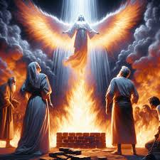
Powerful Acts of Faith #1: 1 Kings 13:16-20
You cannot sacrifice a goat to an Angel!
Don’t ask an angel’s name – it is a secret! If they are meant to tell you, they will
Having an angel ascend in the flame of an alter is not a common occurrence
¹⁶ And the angel of the Lord said unto Manoah, Though thou detain me, I will not eat of thy bread: and if thou wilt offer a burnt offering, thou must offer it unto the Lord. For Manoah knew not that he was an angel of the Lord.
¹⁷ And Manoah said unto the angel of the Lord, What is thy name, that when thy sayings come to pass we may do thee honour?
¹⁸ And the angel of the Lord said unto him, Why askest thou thus after my name, seeing it is secret?
¹⁹ So Manoah took a kid with a meat offering, and offered it upon a rock unto the Lord: and the angel did wonderously; and Manoah and his wife looked on.
²⁰ For it came to pass, when the flame went up toward heaven from off the altar, that the angel of the Lord ascended in the flame of the altar. And Manoah and his wife looked on it, and fell on their faces to the ground.

Slide 7
Powerful Acts of Faith #1: 1 Kings 14:1-5
Chapter 14 Starts with Samson being grown up
Don’t take a philistine as a wife – even if she looks hot!
Being hot alone, though challenging isn’t always the issue
the problem arises when she is just the right kind of hot, for you
then its much harder to resist.
Note: Solomon let women turn his heart away from God
An uncircumcised philistine means that they are a stranger to the convent of promise
14 And Samson went down to Timnath, and saw a woman in Timnath of the daughters of the Philistines.
2 And he came up, and told his father and his mother, and said, I have seen a woman in Timnath of the daughters of the Philistines: now therefore get her for me to wife.
3 Then his father and his mother said unto him, Is there never a woman among the daughters of thy brethren, or among all my people, that thou goest to take a wife of the uncircumcised Philistines? And Samson said unto his father, Get her for me; for she pleaseth me well.
4 But his father and his mother knew not that it was of the Lord, that he sought an occasion against the Philistines: for at that time the Philistines had dominion over Israel.
5 Then went Samson down, and his father and his mother, to Timnath, and came to the vineyards of Timnath: and, behold, a young lion roared against him.

Slide 8
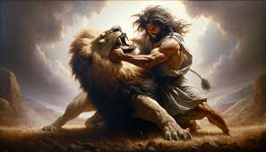
Powerful Acts of Faith #1: 1 Kings 14:6-10
The way the scripture reads it is doesn’t sound like Samson was strong all the time
He was never in fear that his strength wouldn’t come
David did the same thing as Samson
David struck the lion to kill it – that had to be a pretty-hard strike, using his faith
Samson tore the lion apart – perhaps a greater feat of strength, but dead is still dead
Why did he not tell his father and mother about the lion? Again Samson holds information back from his parents
Notice that the swarm of bee’s didn’t deter him – is still another aspect of his strength overlooked?
⁶ And the Spirit of the Lord came mightily upon him, and he rent him as he would have rent a kid, and he had nothing in his hand: but he told not his father or his mother what he had done.
⁷ And he went down, and talked with the woman; and she pleased Samson well.
⁸ And after a time he returned to take her, and he turned aside to see the carcass of the lion: and, behold, there was a swarm of bees and honey in the carcass of the lion.
⁹ And he took thereof in his hands, and went on eating, and came to his father and mother, and he gave them, and they did eat: but he told not them that he had taken the honey out of the carcass of the lion.
¹⁰ So his father went down unto the woman: and Samson made there a feast; for so used the young men to do.

Slide 9
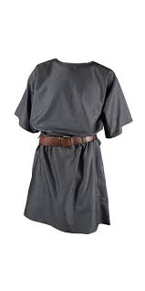
Powerful Acts of Faith #1: 1 Kings 14:11-15
30 sheets and 30 garment changes must have been a rare commodity
Samson’s wife is strong-armed
11 And it came to pass, when they saw him, that they brought thirty companions to be with him.
12 And Samson said unto them, I will now put forth a riddle unto you: if ye can certainly declare it me within the seven days of the feast, and find it out, then I will give you thirty sheets and thirty change of garments:
13 But if ye cannot declare it me, then shall ye give me thirty sheets and thirty change of garments. And they said unto him, Put forth thy riddle, that we may hear it.
14 And he said unto them, Out of the eater came forth meat, and out of the strong came forth sweetness. And they could not in three days expound the riddle.
15 And it came to pass on the seventh day, that they said unto Samson's wife, Entice thy husband, that he may declare unto us the riddle, lest we burn thee and thy father's house with fire: have ye called us to take that we have? is it not so?

Slide 10
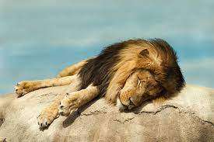
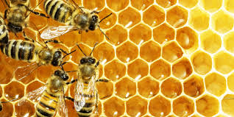
Powerful Acts of Faith #1: 1 Kings 14:16-20
7 days of weeping…
His wife accuses Samson of hating her
She is given to his companion
¹⁶ And Samson's wife wept before him, and said, Thou dost but hate me, and lovest me not: thou hast put forth a riddle unto the children of my people, and hast not told it me. And he said unto her, Behold, I have not told it my father nor my mother, and shall I tell it thee?
¹⁷ And she wept before him the seven days, while their feast lasted: and it came to pass on the seventh day, that he told her, because she lay sore upon him: and she told the riddle to the children of her people.
¹⁸ And the men of the city said unto him on the seventh day before the sun went down, What is sweeter than honey? And what is stronger than a lion? and he said unto them, If ye had not plowed with my heifer, ye had not found out my riddle.
¹⁹ And the Spirit of the Lord came upon him, and he went down to Ashkelon, and slew thirty men of them, and took their spoil, and gave change of garments unto them which expounded the riddle. And his anger was kindled, and he went up to his father's house.
²⁰ But Samson's wife was given to his companion, whom he had used as his friend.

Slide 11
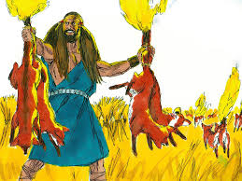
Powerful Acts of Faith #1: 1 Kings 15:1-4
To catch 300 foxes – you have to be pretty fast
15 But it came to pass within a while after, in the time of wheat harvest, that Samson visited his wife with a kid; and he said, I will go in to my wife into the chamber. But her father would not suffer him to go in.
² And her father said, I verily thought that thou hadst utterly hated her; therefore I gave her to thy companion: is not her younger sister fairer than she? take her, I pray thee, instead of her.
³ And Samson said concerning them, Now shall I be more blameless than the Philistines, though I do them a displeasure.
⁴ And Samson went and caught three hundred foxes, and took firebrands, and turned tail to tail, and put a firebrand in the midst between two tails.
⁵ And when he had set the brands on fire, he let them go into the standing corn of the Philistines, and burnt up both the shocks, and also the standing corn, with the vineyards and olives.

Slide 12
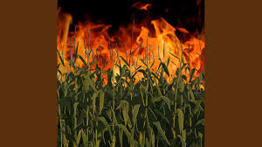
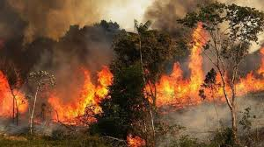
Powerful Acts of Faith #1: 1 Kings 15:5
Smoke, fire & rapid destruction
⁵ And when he had set the brands on fire, he let them go into the standing corn of the Philistines, and burnt up both the shocks, and also the standing corn, with the vineyards and olives.
Wheat Field
Olive Trees

Slide 13
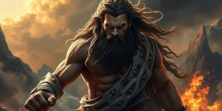
Powerful Acts of Faith #1: 1 Kings 15:6-10
Samson’s countenance
What happens here is just horrific
Just imagine what Samson was feeling
⁶ Then the Philistines said, Who hath done this? And they answered, Samson, the son in law of the Timnite, because he had taken his wife, and given her to his companion. And the Philistines came up, and burnt her and her father with fire.
⁷ And Samson said unto them, Though ye have done this, yet will I be avenged of you, and after that I will cease.
⁸ And he smote them hip and thigh with a great slaughter: and he went down and dwelt in the top of the rock Etam.
⁹ Then the Philistines went up, and pitched in Judah, and spread themselves in Lehi.
¹⁰ And the men of Judah said, Why are ye come up against us? And they answered, To bind Samson are we come up, to do to him as he hath done to us.

Slide 14
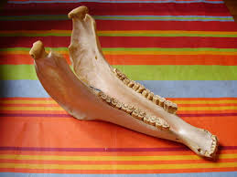
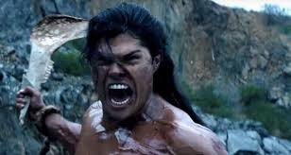
Powerful Acts of Faith #1: 1 Kings 15:11-16
It takes both strength and stamina to slay 1000 men – a lot of it
¹¹ Then three thousand men of Judah went to the top of the rock Etam, and said to Samson, Knowest thou not that the Philistines are rulers over us? what is this that thou hast done unto us? And he said unto them, As they did unto me, so have I done unto them.
¹² And they said unto him, We are come down to bind thee, that we may deliver thee into the hand of the Philistines. And Samson said unto them, Swear unto me, that ye will not fall upon me yourselves.
¹³ And they spake unto him, saying, No; but we will bind thee fast, and deliver thee into their hand: but surely we will not kill thee. And they bound him with two new cords, and brought him up from the rock.
¹⁴ And when he came unto Lehi, the Philistines shouted against him: and the Spirit of the Lord came mightily upon him, and the cords that were upon his arms became as flax that was burnt with fire, and his bands loosed from off his hands.
¹⁵ And he found a new jawbone of an ass, and put forth his hand, and took it, and slew a thousand men therewith.
¹⁶ And Samson said, With the jawbone of an ass, heaps upon heaps, with the jaw of an ass have I slain a thousand men.

Slide 15
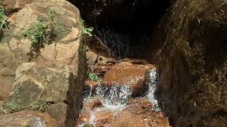
Powerful Acts of Faith #1: 1 Kings 15:17-20
Samsons strength did not extend to water – he still needed it
Samson was quick to accuse the Lord
God caused water to come from a hollow place in the rocks
¹⁷ And it came to pass, when he had made an end of speaking, that he cast away the jawbone out of his hand, and called that place Ramathlehi.
¹⁸ And he was sore athirst, and called on the Lord, and said, Thou hast given this great deliverance into the hand of thy servant: and now shall I die for thirst, and fall into the hand of the uncircumcised?
¹⁹ But God clave an hollow place that was in the jaw, and there came water thereout; and when he had drunk, his spirit came again, and he revived: wherefore he called the name thereof Enhakkore, which is in Lehi unto this day.
²⁰ And he judged Israel in the days of the Philistines twenty years.

Slide 16
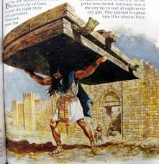
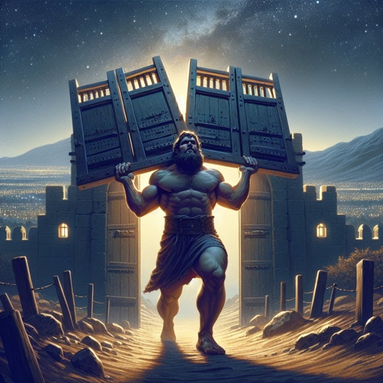
Powerful Acts of Faith #1: 1 Kings 16:1-5
Gates are heavy – let alone carrying them for half a day, uphill
1100x hundred pieces of silver – The plot to kill Samson begins
16 Then went Samson to Gaza, and saw there an harlot, and went in unto her.
² And it was told the Gazites, saying, Samson is come hither. And they compassed him in, and laid wait for him all night in the gate of the city, and were quiet all the night, saying, In the morning, when it is day, we shall kill him.
³ And Samson lay till midnight, and arose at midnight, and took the doors of the gate of the city, and the two posts, and went away with them, bar and all, and put them upon his shoulders, and carried them up to the top of an hill that is before Hebron.
⁴ And it came to pass afterward, that he loved a woman in the valley of Sorek, whose name was Delilah.
⁵ And the lords of the Philistines came up unto her, and said unto her, Entice him, and see wherein his great strength lieth, and by what means we may prevail against him, that we may bind him to afflict him; and we will give thee every one of us eleven hundred pieces of silver.

Slide 17
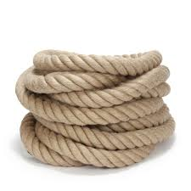
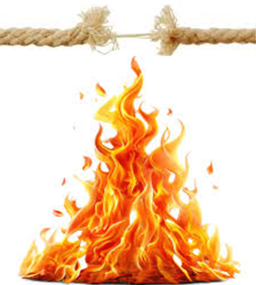
Powerful Acts of Faith #1: 1 Kings 16:6-10
His strength was so great that breaking the ropes was like snapping a tiny thread with fire
This doesn’t feel like the same kind of mocking that Elijah did – more like borderline arrogance
⁶ And Delilah said to Samson, Tell me, I pray thee, wherein thy great strength lieth, and wherewith thou mightest be bound to afflict thee.
⁷ And Samson said unto her, If they bind me with seven green withs that were never dried, then shall I be weak, and be as another man.
⁸ Then the lords of the Philistines brought up to her seven green withs which had not been dried, and she bound him with them.
⁹ Now there were men lying in wait, abiding with her in the chamber. And she said unto him, The Philistines be upon thee, Samson. And he brake the withs, as a thread of tow is broken when it toucheth the fire. So his strength was not known.
¹⁰ And Delilah said unto Samson, Behold, thou hast mocked me, and told me lies: now tell me, I pray thee, wherewith thou mightest be bound.

Slide 18
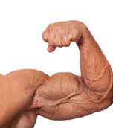
Powerful Acts of Faith #1: 1 Kings 16:11-15
You would have thought that Samson would have learned from the first time this woman sold him out, but his confidence shifts to his strength instead of his confidence being in God and his eyes are still blinded by beauty
¹¹ And he said unto her, If they bind me fast with new ropes that never were occupied, then shall I be weak, and be as another man.
¹² Delilah therefore took new ropes, and bound him therewith, and said unto him, The Philistines be upon thee, Samson. And there were liers in wait abiding in the chamber. And he brake them from off his arms like a thread.
¹³ And Delilah said unto Samson, Hitherto thou hast mocked me, and told me lies: tell me wherewith thou mightest be bound. And he said unto her, If thou weavest the seven locks of my head with the web.
¹⁴ And she fastened it with the pin, and said unto him, The Philistines be upon thee, Samson. And he awaked out of his sleep, and went away with the pin of the beam, and with the web.
¹⁵ And she said unto him, How canst thou say, I love thee, when thine heart is not with me? thou hast mocked me these three times, and hast not told me wherein thy great strength lieth.

Slide 19
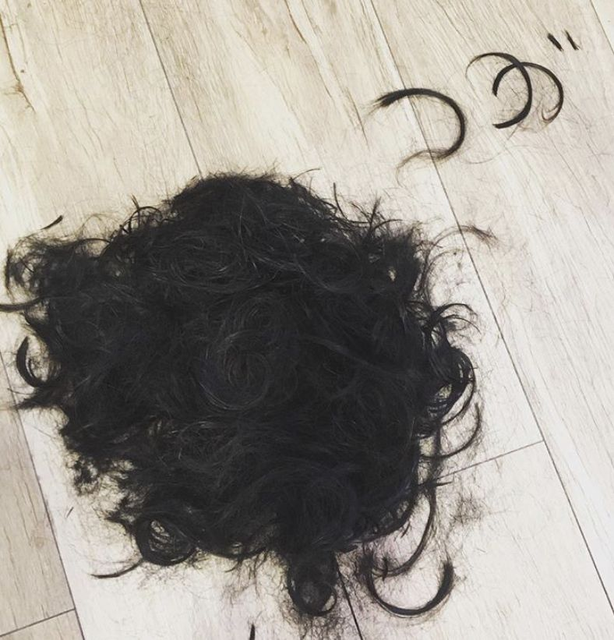
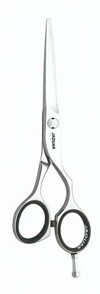
Powerful Acts of Faith #1: 1 Kings 16:16-20
Samson’s hair is cut – and he loses his strength
He knew he would become weak – and yet he told her anyway
Samson didn’t know that the Lord had departed from him – that’s a dangerous place to be in
¹⁶ And it came to pass, when she pressed him daily with her words, and urged him, so that his soul was vexed unto death;
¹⁷ That he told her all his heart, and said unto her, There hath not come a razor upon mine head; for I have been a Nazarite unto God from my mother's womb: if I be shaven, then my strength will go from me, and I shall become weak, and be like any other man.
¹⁸ And when Delilah saw that he had told her all his heart, she sent and called for the lords of the Philistines, saying, Come up this once, for he hath shewed me all his heart. Then the lords of the Philistines came up unto her, and brought money in their hand.
1 Timothy 6:10 [For the love of money is the root of all evil: which while some coveted after, they have erred from the faith, and pierced themselves through with many sorrows.]
¹⁹ And she made him sleep upon her knees; and she called for a man, and she caused him to shave off the seven locks of his head; and she began to afflict him, and his strength went from him.
²⁰ And she said, The Philistines be upon thee, Samson. And he awoke out of his sleep, and said, I will go out as at other times before, and shake myself. And he wist not that the Lord was departed from him.

Slide 20
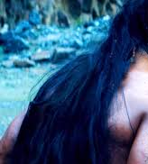
Powerful Acts of Faith #1: 1 Kings 16:21-26
Samson’s hair begins to grow
Remember this was the one key to his strength
No razors
²¹ But the Philistines took him, and put out his eyes, and brought him down to Gaza, and bound him with fetters of brass; and he did grind in the prison house.
²² Howbeit the hair of his head began to grow again after he was shaven.
²³ Then the lords of the Philistines gathered them together for to offer a great sacrifice unto Dagon their god, and to rejoice: for they said, Our god hath delivered Samson our enemy into our hand.
²⁴ And when the people saw him, they praised their god: for they said, Our god hath delivered into our hands our enemy, and the destroyer of our country, which slew many of us.
²⁵ And it came to pass, when their hearts were merry, that they said, Call for Samson, that he may make us sport. And they called for Samson out of the prison house; and he made them sport: and they set him between the pillars.
²⁶ And Samson said unto the lad that held him by the hand, Suffer me that I may feel the pillars whereupon the house standeth, that I may lean upon them.

Slide 21
Powerful Acts of Faith #1: 1 Kings 16:11-15
Samsons last act of Faith
Remember me
Strengthen me
Why did it take all his might to push he pillars?
²⁷ Now the house was full of men and women; and all the lords of the Philistines were there; and there were upon the roof about three thousand men and women, that beheld while Samson made sport.
²⁸ And Samson called unto the Lord, and said, O Lord God, remember me, I pray thee, and strengthen me, I pray thee, only this once, O God, that I may be at once avenged of the Philistines for my two eyes.
²⁹ And Samson took hold of the two middle pillars upon which the house stood, and on which it was borne up, of the one with his right hand, and of the other with his left.
³⁰ And Samson said, Let me die with the Philistines. And he bowed himself with all his might; and the house fell upon the lords, and upon all the people that were therein. So the dead which he slew at his death were more than they which he slew in his life.

Slide 22
The take away
When God gives you an extraordinary gift,
don’t squander it!

