Slide 1
The Hall of Faith
Your Destination
Applied Faith
Part # 3
As we walk through the hall of faith and see posters on the left & right walls of the elders and the prophets: Abel, Enoch, Noah, Abraham, Sara, Isaac, Joseph, Moses, Rahab, Gideon, Barak, Samson, Jephthae, David, and Samuel.
A Refuge City Church
Bible - Study
https://www.mathcompiler3d.com/bible-study

Slide 2
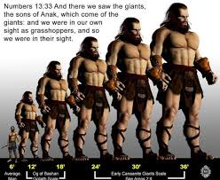
Obtaining a good report
The elders obtains a good report by faith
What is a good report? – We are well able to take the land!
Numbers 13:30 30 And Caleb stilled the people before Moses, and said, Let us go up at once, and possess it; for we are well able to overcome it.
What is a bad report? – We were in our own sight as grasshoppers
Numbers 13:33
33 And there we saw the giants, the sons of Anak, which come of the giants: and we were in our own sight as grasshoppers, and so we were in their sight.
Hebrews 11:1-2
11 Now faith is the substance of things hoped for, the evidence of things not seen.
² For by it the elders obtained a good report.

Slide 3
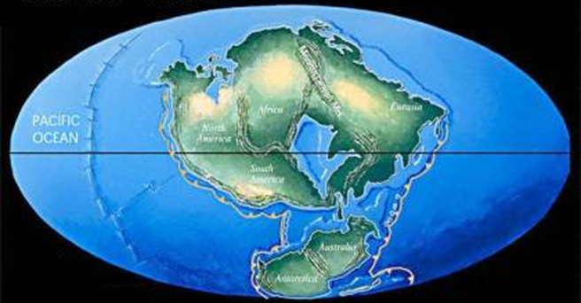
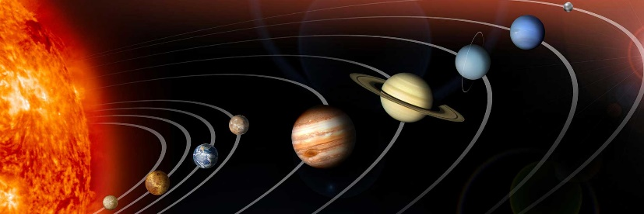
The Worlds were framed by the Word of God
If the Worlds were frame by the Word, what can you do with it? The Word is nigh, thee, even in thy mouth
The Worlds were framed by the Word of God
Things that were made – were not made of things that appear
When you are using your Faith to believe God for an answer to prayer, we cannot based our progress in receiving on physical circumstances. Faith cannot be seen with the natural eyes.
Hebrews 11:3
³ Through faith we understand that the worlds were framed by the word of God, so that things which are seen were not made of things which do appear.

Slide 4
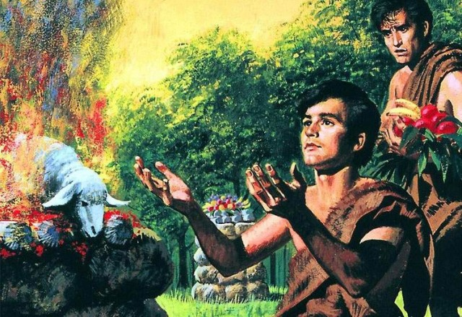
A more excellent sacrifice
By Faith Abel Offered a more excellent sacrifice
Even in death, his testimony still speaks – when you go to heaven, what will your testimony say
Hebrews 11:4
4 By faith Abel offered unto God a more excellent sacrifice than Cain, by which he obtained witness that he was righteous, God testifying of his gifts: and by it he being dead yet speaketh.

Slide 5
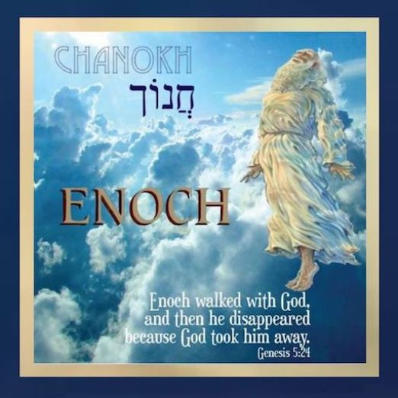
Translated that he should not see death
Enoch was Translated that he should not see death
He walked with God for 365 years
There are two types of translation – one from A to B and one from Earth to Heaven
Having a testimony that he pleased God – means that he had a life style of Faith – without faith it is impossible to please God
Enoch was translated so that “He would not see death” – which means there is a purpose in it. It is appointed unto men to die once – Hebrews 9:27
Hebrews 11:5
⁵ By faith Enoch was translated that he should not see death; and was not found, because God had translated him: for before his translation he had this testimony, that he pleased God.
Genesis 5:24
²⁴ And Enoch walked with God: and he was not; for God took him.

Slide 6
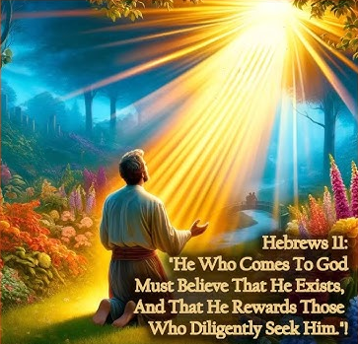
Translated that he should not see death
Faith is required to please God
You must come to God and believe that he is
You must also believe that he is a rewarder of them that diligently seek him
Faith is required in both areas – some folks leave the second one out (diligently seek him)
Hebrews 11:6
6 But without faith it is impossible to please him: for he that cometh to God must believe that he is, and that he is a rewarder of them that diligently seek him.

Slide 7
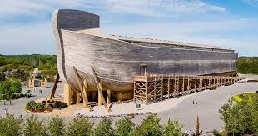
By Faith Noah prepared an Ark to the saving of his house
He was warned of God of things not seen as yet
He became an heir of the righteousness which is by faith
Rain had not existed on the earth – they didn’t know what it was
The whole town probably laughed at him.
Hebrews 11:7
⁷ By faith Noah, being warned of God of things not seen as yet, moved with fear, prepared an ark to the saving of his house; by the which he condemned the world, and became heir of the righteousness which is by faith.

Slide 8
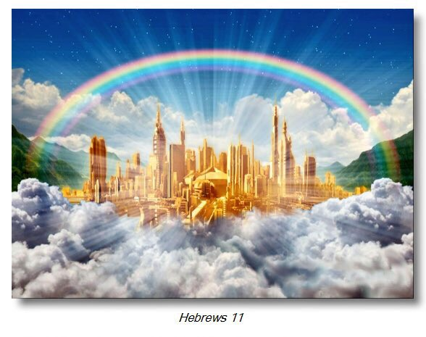
Based on Faith alone, Abraham went ouf of this own country to an unknown location
He looked for a city which had foundations, whose builder and maker is God
No forwarding address -
No way to plan
Hebrews 11:8-10
8 By faith Abraham, when he was called to go out into a place which he should after receive for an inheritance, obeyed; and he went out, not knowing whither he went.
9 By faith he sojourned in the land of promise, as in a strange country, dwelling in tabernacles with Isaac and Jacob, the heirs with him of the same promise:
10 For he looked for a city which hath foundations, whose builder and maker is God.

Slide 9
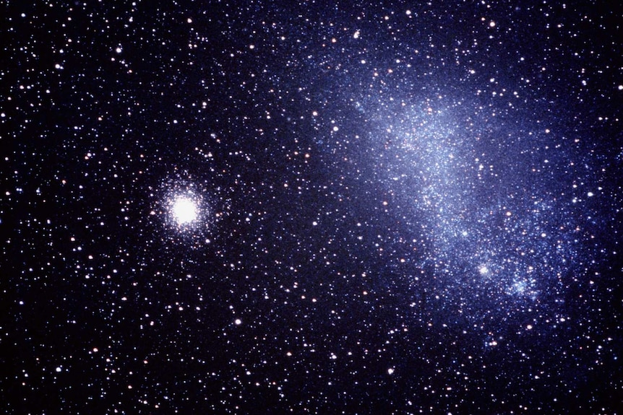
Sarah received strength to conceive seed when she was old
So many as the stars of the sky in multitude, and the sand of the sea unnumerable
Hebrews 11:8-9
¹¹ Through faith also Sara herself received strength to conceive seed, and was delivered of a child when she was past age, because she judged him faithful who had promised.
¹² Therefore sprang there even of one, and him as good as dead, so many as the stars of the sky in multitude, and as the sand which is by the sea shore innumerable.

Slide 10
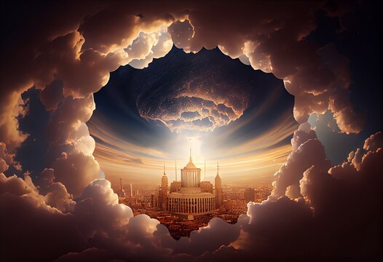
But now they desire a better country
They were strangers and pilgrims on earth
God is not ashamed to becalled their God
Hebrews 11:13-16
¹³ These all died in faith, not having received the promises, but having seen them afar off, and were persuaded of them, and embraced them, and confessed that they were strangers and pilgrims on the earth.
¹⁴ For they that say such things declare plainly that they seek a country.
¹⁵ And truly, if they had been mindful of that country from whence they came out, they might have had opportunity to have returned.
¹⁶ But now they desire a better country, that is, an heavenly: wherefore God is not ashamed to be called their God: for he hath prepared for them a city.

Slide 11
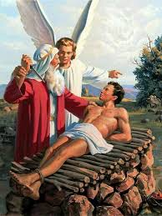
Abraham was willing to offer up Isaac, which gave God the right to offer his son as a sacrifice for us
God gave Abraham a vision of Isaac being raised from the dead
Hebrews 11:17-19
17 By faith Abraham, when he was tried, offered up Isaac: and he that had received the promises offered up his only begotten son,
18 Of whom it was said, That in Isaac shall thy seed be called:
19 Accounting that God was able to raise him up, even from the dead; from whence also he received him in a figure.

Slide 12
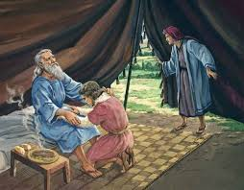
Jacob & Esau were blessed by Faith from Isaac concerning things to come
Hebrews 11:20
By faith Isaac blessed Jacob and Esau concerning things to come.

Slide 13
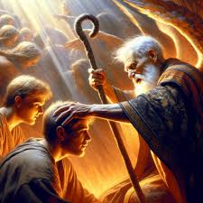
By Faith Jacob blesses the sons of Joseph
Hebrews 11:21
21 By faith Jacob, when he was a dying, blessed both the sons of Joseph; and worshipped, leaning upon the top of his staff.

Slide 14
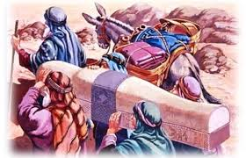
By Faith Joseph gave commandment concerning his bones.
Hebrews 11:22
By faith Joseph, when he died, made mention of the departing of the children of Israel; and gave commandment concerning his bones.

Slide 15
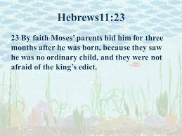
By Faith Moses parents hid him
Hebrews 11:23
23 By faith Moses, when he was born, was hid three months of his parents, because they saw he was a proper child; and they were not afraid of the king's commandment.

Slide 16
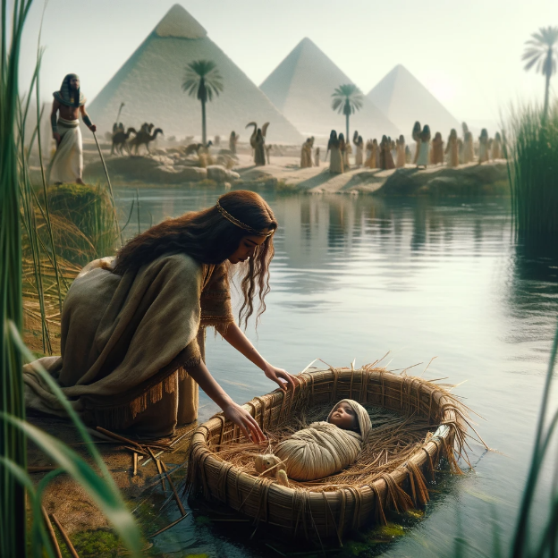
By Faith Moses refused to be called the son of Pharaoh’s Daughter
Being right with God was more important than sin for a sin
Hebrews 11:24-26
²⁴ By faith Moses, when he was come to years, refused to be called the son of Pharaoh's daughter;
²⁵ Choosing rather to suffer affliction with the people of God, than to enjoy the pleasures of sin for a season;
²⁶ Esteeming the reproach of Christ greater riches than the treasures in Egypt: for he had respect unto the recompence of the reward.

Slide 17
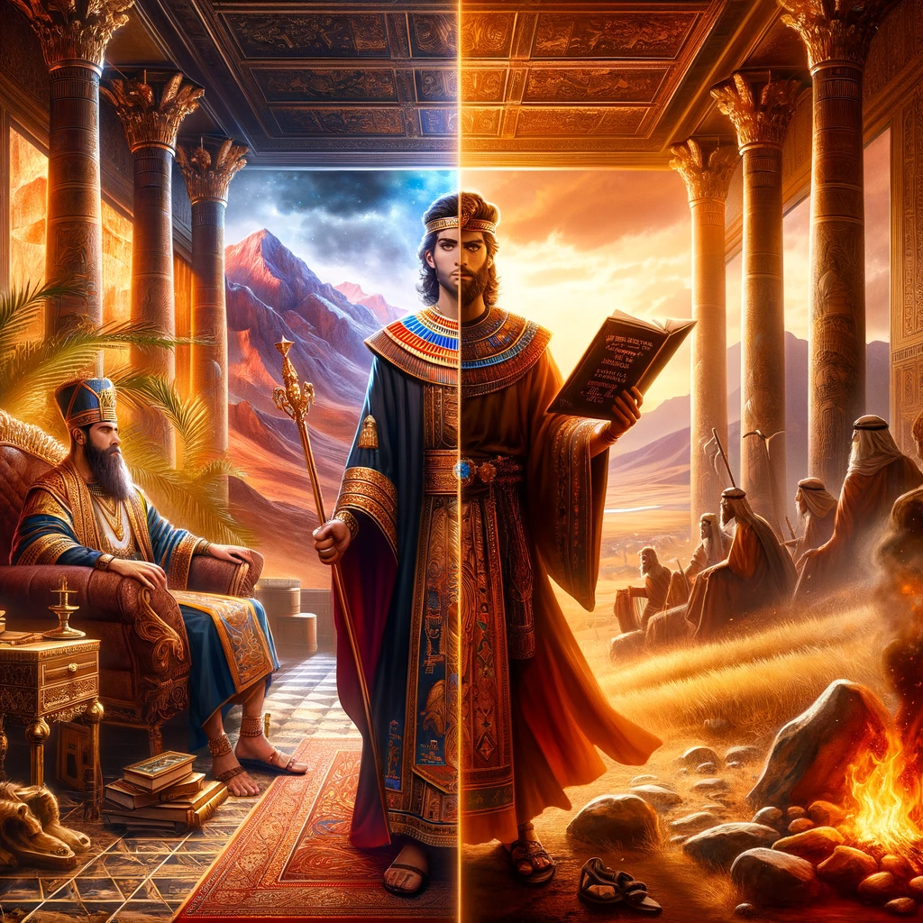
By Faith Moses forsakes Egypt
Moses chooses not to fear the wrath of the King
Hebrews 11:27
²⁷ By faith he forsook Egypt, not fearing the wrath of the king: for he endured, as seeing him who is invisible.

Slide 18
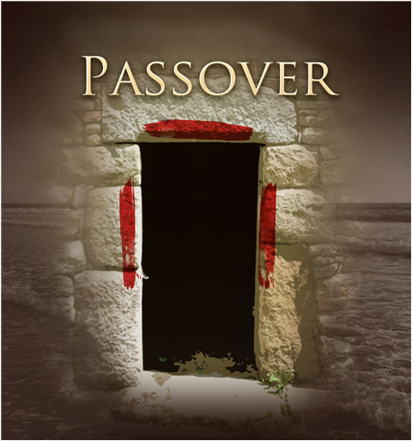
By Faith Moses Keeps the Passover
Hebrews 11:29
28 Through faith he kept the passover, and the sprinkling of blood, lest he that destroyed the firstborn should touch them.

Slide 19
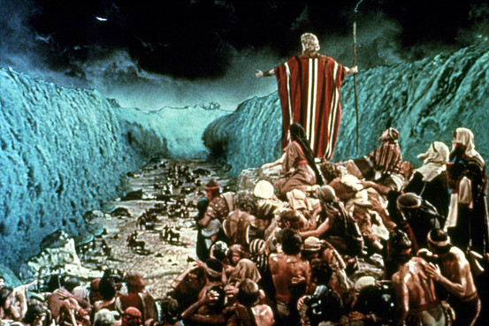
By Faith Moses leads the children of Israel through the red sea
Hebrews 11:29
By faith they passed through the Red sea as by dry land: which the Egyptians assaying to do were drowned.

Slide 20
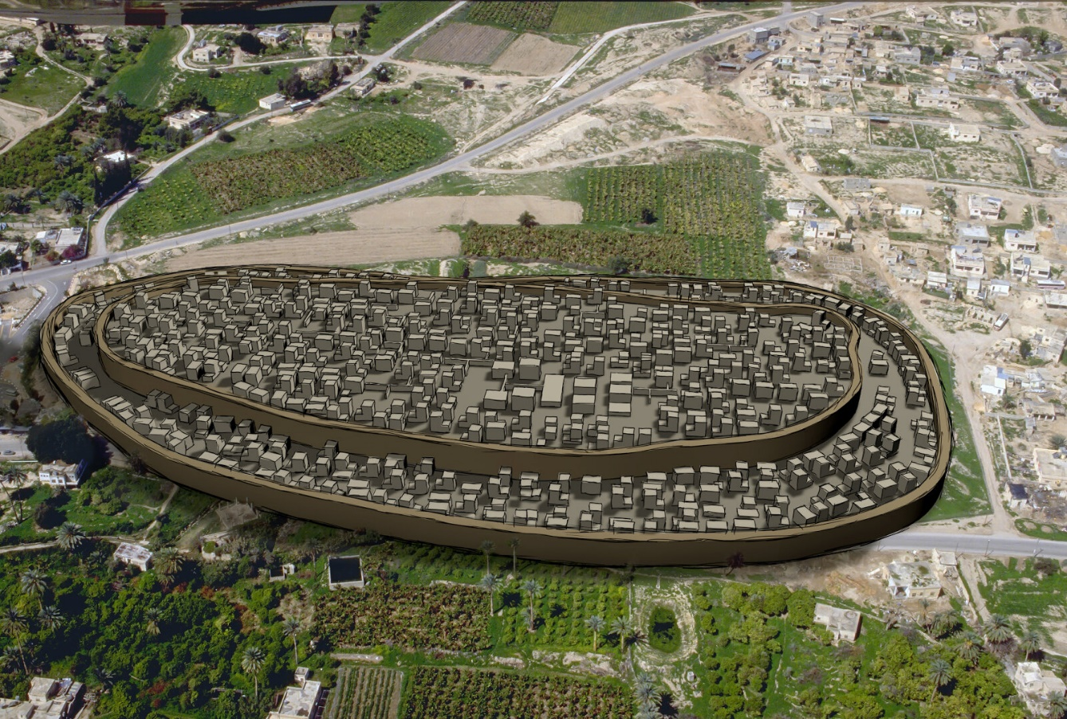
7 days – 7 times
For 6 days they walked around Jericho and nothing happened
The 7th day, that had to walk around it 7 times.
Hebrews 11:30
³⁰ By faith the walls of Jericho fell down, after they were compassed about seven days.

Slide 21
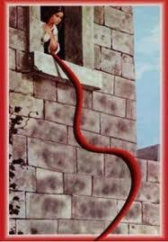
God pay’s attention to red cords
Its more important to God what you believe, then what your past is
Hebrews 11:31
31 By faith the harlot Rahab perished not with them that believed not, when she had received the spies with peace.

Slide 22
And what more shall I say?
Hebrews 11:32 - 40
³² And what shall I more say? for the time would fail me to tell of Gedeon, and of Barak, and of Samson, and of Jephthae; of David also, and Samuel, and of the prophets:
³³ Who through faith subdued kingdoms, wrought righteousness, obtained promises, stopped the mouths of lions.
³⁴ Quenched the violence of fire, escaped the edge of the sword, out of weakness were made strong, waxed valiant in fight, turned to flight the armies of the aliens.
³⁵ Women received their dead raised to life again: and others were tortured, not accepting deliverance; that they might obtain a better resurrection:
³⁶ And others had trial of cruel mockings and scourgings, yea, moreover of bonds and imprisonment:
³⁷ They were stoned, they were sawn asunder, were tempted, were slain with the sword: they wandered about in sheepskins and goatskins; being destitute, afflicted, tormented;
³⁸ (Of whom the world was not worthy:) they wandered in deserts, and in mountains, and in dens and caves of the earth.
³⁹ And these all, having obtained a good report through faith, received not the promise:
⁴⁰ God having provided some better thing for us, that they without us should not be made perfect.

Slide 23
Hall of Faith Summary
The just shall live by faith
Faith always speaks the desired end-result
Faith does not take into account the circumstances in the natural
Faith gives substance in the natural, to unseen things in the supernatural
Faith calls things that are not as though they were
Faith without works is dead
Faith requires action – (As they went, they were healed)
Make sure God has pleasure in you
^{Hebrews 10:38}
³⁸ Now the just shall live by faith: but if any man draw back, my soul shall have no pleasure in him.

