Slide 1
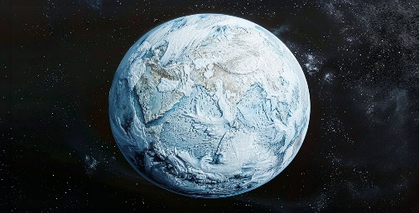
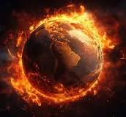
End Times & Pre Times: The Earth Lease
Revelation 1:3
³ Blessed is he that readeth, and they that hear the words of this prophecy, and keep those things which are written therein: for the time is at hand.
To learn what is to come, we must learn what was
Ecclesiastes 1:9
⁹ The thing that hath been, it is that which shall be; and that which is done is that which shall be done: and there is no new thing under the sun.
The Earth Lease
Part 1
Some say the World will end by fire
Others say by Ice
But from what I know about Desire
I hold with those that favor fire
But if the world must perish twice
I think I’ve learn enough of hate
To say that for destruction ice is also great
And would suffice
We know through scripture that the world will perish in fire
^{2 Peter 3:10}
¹⁰ But the day of the Lord will come as a thief in the night; in the which the heavens shall pass away with a great noise, and the elements shall melt with fervent heat, the earth also and the works that are therein shall be burned up.
A Refuge City Church
Bible - Study
We know we are in the last days of the end times – and time is very short. Although we don’t know the day and the hour of the return of Jesus, we might be able to know the season.
https://www.mathcompiler3d.com/bible-study

Slide 2
End Times & Pre-Times: What is a Lease?
^{50 x 120 = 6000}
Lease – a contract by which one part conveys land, property, services, etc. to another for a specified time, usually in return for a periodic payment.
^{Psalm 115:16}
^{Genesis 2:16-18}
16 The heaven, even the heavens, are the Lord's: but the earth hath he given to the children of men.
17 but of the tree of the knowledge of good and evil, thou shalt not eat of it. For in the day that thou eatest thereof, thou shalt surely die.”
^{Genesis 6:3}
3 And the Lord said, My spirit shall not always strive with man, for that he also is flesh: yet his days shall be an hundred and twenty years.
^{Genesis 5:5}
^{Leviticus 25:8-10}
5 And all the days that Adam lived were nine hundred and thirty years: and he died.
8 And thou shalt number seven sabbaths of years unto thee, seven times seven years; and the space of the seven sabbaths of years shall be unto thee forty and nine years.
9 Then shalt thou cause the trumpet of the jubile to sound on the tenth day of the seventh month, in the day of atonement shall ye make the trumpet sound throughout all your land.
10 And ye shall hallow the fiftieth year, and proclaim liberty throughout all the land unto all the inhabitants thereof: it shall be a jubile unto you; and ye shall return every man unto his possession, and ye shall return every man unto his family.
^{2 Peter 3:7-9}
8 But, beloved, be not ignorant of this one thing: that with the Lord one day is as a thousand years, and a thousand years as one day.

Slide 3
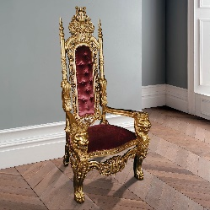
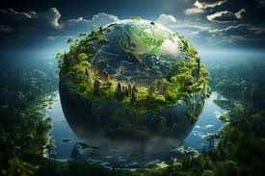
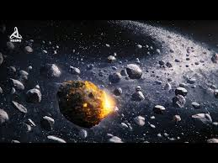
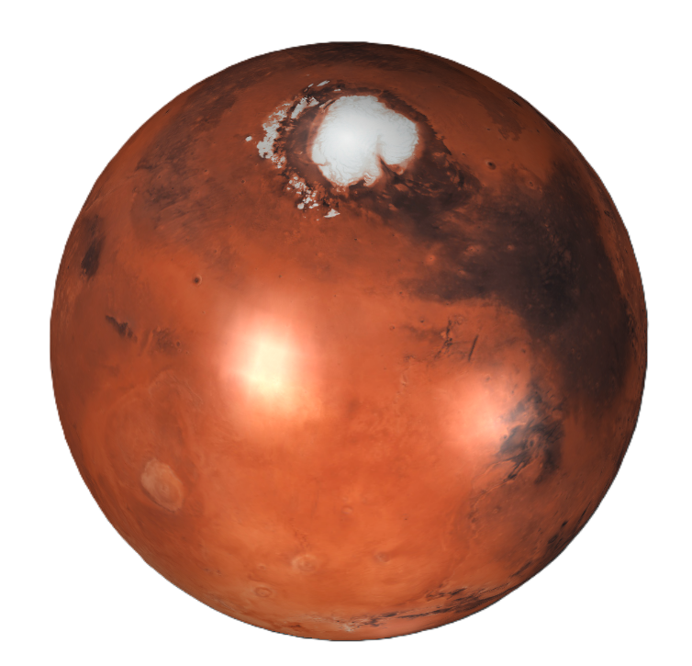
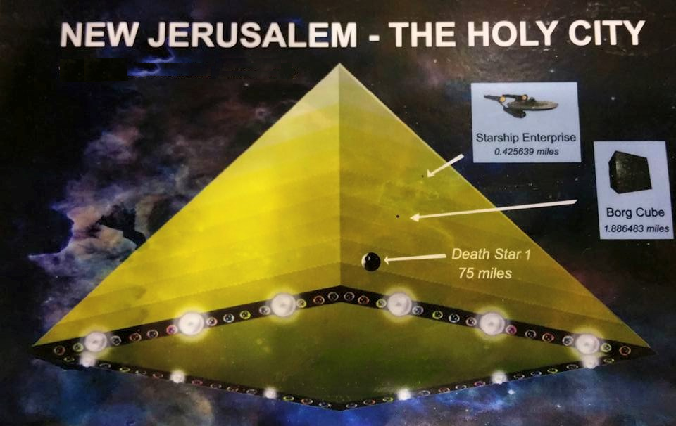
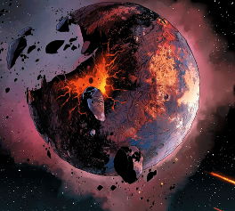
End Times & Pre-Times: A Flood Before Noah?
Lucifer rules a
kingdom on earth
In the beginning God created the heaven and the earth.
He loosed not the house of his prisoners resulting in judgment
Rahab
Mars
The Ice Age on Earth
Lucifers Flood
The Make-over 6000 +/- years ago – and God said…
The World that
Was - Giants
In Genesis 1:2 – we arrive on a planet that has been totally flooded – meaning it had already existed before hand. The earth was without form and void (suggesting that a major destruction / judgment had taken place) – darkness was everywhere – illuding to the fact that there was no sun present.
End of Millenium
God Dwells with his people
Noah’s Flood
After Noah’s
Flood
New Heaven & Earth

Slide 4
End Times & Pre-Times: How long were the days in Genesis 6?
The light wasn’t the sun – the greater light wasn’t created until verse 16.
5 Scripture Verses

Slide 5
End Times & Pre-Times: The Evening and the morning
Genesis 1:3-10
The Evening and the Morning were the “first” day
The 6 days in genesis illustrated in Genesis are 24 hour periods, but they represent 1000 years.
And God said, Let there be light: and there was light.
⁴ And God saw the light, that it was good: and God divided the light from the darkness.
⁵ And God called the light Day, and the darkness he called Night. And the evening and the morning were the first day.
⁶ And God said, Let there be a firmament in the midst of the waters, and let it divide the waters from the waters.
⁷ And God made the firmament, and divided the waters which were under the firmament from the waters which were above the firmament: and it was so.
⁸ And God called the firmament Heaven. And the evening and the morning were the second day.
⁹ And God said, Let the waters under the heaven be gathered together unto one place, and let the dry land appear: and it was so.
¹⁰ And God called the dry land Earth; and the gathering together of the waters called he Seas: and God saw that it was good.

Slide 6
End Times & Pre-Times: and let them before signs
Genesis 1:11-17
¹¹ And God said, Let the earth bring forth grass, the herb yielding seed, and the fruit tree yielding fruit after his kind, whose seed is in itself, upon the earth: and it was so.
¹² And the earth brought forth grass, and herb yielding seed after his kind, and the tree yielding fruit, whose seed was in itself, after his kind: and God saw that it was good.
¹³ And the evening and the morning were the third day.
¹⁴ And God said, Let there be lights in the firmament of the heaven to divide the day from the night; and let them be for signs, and for seasons, and for days, and years:
¹⁵ And let them be for lights in the firmament of the heaven to give light upon the earth: and it was so.
¹⁶ And God made two great lights; the greater light to rule the day, and the lesser light to rule the night: he made the stars also.
¹⁷ And God set them in the firmament of the heaven to give light upon the earth,
¹⁸ And to rule over the day and over the night, and to divide the light from the darkness: and God saw that it was good.
¹⁹ And the evening and the morning were the fourth day.
²⁰ And God said, Let the waters bring forth abundantly the moving creature that hath life, and fowl that may fly above the earth in the open firmament of heaven.

Slide 7
End Times & Pre-Times: and let them before signs
Genesis 1:11-17
²¹ And God created great whales, and every living creature that moveth, which the waters brought forth abundantly, after their kind, and every winged fowl after his kind: and God saw that it was good.
²² And God blessed them, saying, Be fruitful, and multiply, and fill the waters in the seas, and let fowl multiply in the earth.
²³ And the evening and the morning were the fifth day.
²⁴ And God said, Let the earth bring forth the living creature after his kind, cattle, and creeping thing, and beast of the earth after his kind: and it was so.
²⁵ And God made the beast of the earth after his kind, and cattle after their kind, and every thing that creepeth upon the earth after his kind: and God saw that it was good.
²⁶ And God said, Let us make man in our image, after our likeness: and let them have dominion over the fish of the sea, and over the fowl of the air, and over the cattle, and over all the earth, and over every creeping thing that creepeth upon the earth.
²⁷ So God created man in his own image, in the image of God created he him; male and female created he them.
²⁸ And God blessed them, and God said unto them, Be fruitful, and multiply, and replenish the earth, and subdue it: and have dominion over the fish of the sea, and over the fowl of the air, and over every living thing that moveth upon the earth.
²⁹ And God said, Behold, I have given you every herb bearing seed, which is upon the face of all the earth, and every tree, in the which is the fruit of a tree yielding seed; to you it shall be for meat.
³⁰ And to every beast of the earth, and to every fowl of the air, and to every thing that creepeth upon the earth, wherein there is life, I have given every green herb for meat: and it was so.
³¹ And God saw every thing that he had made, and, behold, it was very good. And the evening and the morning were the sixth day.

Slide 8
End Times & Pre-Times: The Evening and the morning
I am God – there is none like me
God declares the end from the beginning
Isaiah 46:9 – 10
⁹ Remember the former things of old: for I am God, and there is none else; I am God, and there is none like me,
¹⁰ Declaring the end from the beginning, and from ancient times the things that are not yet done, saying, My counsel shall stand, and I will do all my pleasure:

Slide 9
End Times & Pre-Times: There is none like me
I am God – there is none like me
God declares the end from the beginning
Isaiah 46:9 – 10
⁹ Remember the former things of old: for I am God, and there is none else; I am God, and there is none like me,
¹⁰ Declaring the end from the beginning, and from ancient times the things that are not yet done, saying, My counsel shall stand, and I will do all my pleasure:

Slide 10
End Times & Pre-Times:
Where is the promise
of his coming?
Vs. 4 - Scoffers say, where is the Promise of his coming?
Vs 5 - They are willing ignorant that the heavens were of old
Vs 5 – The earth was standing out of the water and in the water
Vs 8 - A day with the Lord is like a thousand years – be not ignorant of this!
Vs 9 – The Lord is not slack concerning his promises
2 Peter 3:1-13
This second epistle, beloved, I now write unto you; in both which I stir up your pure minds by way of remembrance:
² That ye may be mindful of the words which were spoken before by the holy prophets, and of the commandment of us the apostles of the Lord and Saviour:
³ Knowing this first, that there shall come in the last days scoffers, walking after their own lusts,
⁴ And saying, Where is the promise of his coming? for since the fathers fell asleep, all things continue as they were from the beginning of the creation.
⁵ For this they willingly are ignorant of, that by the word of God the heavens were of old, and the earth standing out of the water and in the water:
⁶ Whereby the world that then was, being overflowed with water, perished:
⁷ But the heavens and the earth, which are now, by the same word are kept in store, reserved unto fire against the day of judgment and perdition of ungodly men.
⁸ But, beloved, be not ignorant of this one thing, that one day is with the Lord as a thousand years, and a thousand years as one day.
⁹ The Lord is not slack concerning his promise, as some men count slackness; but is longsuffering to us-ward, not willing that any should perish, but that all should come to repentance.
¹⁰ But the day of the Lord will come as a thief in the night; in the which the heavens shall pass away with a great noise, and the elements shall melt with fervent heat, the earth also and the works that are therein shall be burned up.
¹¹ Seeing then that all these things shall be dissolved, what manner of persons ought ye to be in all holy conversation and godliness,
¹² Looking for and hasting unto the coming of the day of God, wherein the heavens being on fire shall be dissolved, and the elements shall melt with fervent heat?
¹³ Nevertheless we, according to his promise, look for new heavens and a new earth, wherein dwelleth righteousness.

Slide 11
End Times & Pre-Times:
The rapture
The rapture of the Church is not the second advent – in the rapture, Jesus appears in the clouds
Book 20:1-6
Scripture

Slide 12
End Times & Pre-Times:
The tribulation
Statement
Book 20:1-6
Scripture

Slide 13
End Times & Pre-Times:
The Key of the bottomless pit
Satan will not deceive the nations until after the 1000 years
Revelation 20:1-6
20 And I saw an angel come down from heaven, having the key of the bottomless pit and a great chain in his hand.
2 And he laid hold on the dragon, that old serpent, which is the Devil, and Satan, and bound him a thousand years,
3 And cast him into the bottomless pit, and shut him up, and set a seal upon him, that he should deceive the nations no more, till the thousand years should be fulfilled: and after that he must be loosed a little season.
4 And I saw thrones, and they sat upon them, and judgment was given unto them: and I saw the souls of them that were beheaded for the witness of Jesus, and for the word of God, and which had not worshipped the beast, neither his image, neither had received his mark upon their foreheads, or in their hands; and they lived and reigned with Christ a thousand years.
5 But the rest of the dead lived not again until the thousand years were finished. This is the first resurrection.
6 Blessed and holy is he that hath part in the first resurrection: on such the second death hath no power, but they shall be priests of God and of Christ, and shall reign with him a thousand years.

Slide 14
End Times & Pre-Times:
And when the thousand years are expired
Satan is loosed for a season after the 1000 years
Revelation 20:7-8
⁷ And when the thousand years are expired, Satan shall be loosed out of his prison,
⁸ And shall go out to deceive the nations which are in the four quarters of the earth, Gog, and Magog, to gather them together to battle: the number of whom is as the sand of the sea.

Slide 15
End Times & Pre-Times:
That great city, the holy Jerusalem,
descending out of heaven from God
There was no more sea
God wipes away all tears
There is no more pain, death, sorrow, or crying
Behold God makes all things new
There are 12 gates on the New Jerusalem
The walls had 12 foundations with the names of the Apostles
Revelation 21:1-5
21 And I saw a new heaven and a new earth: for the first heaven and the first earth were passed away; and there was no more sea.
² And I John saw the holy city, new Jerusalem, coming down from God out of heaven, prepared as a bride adorned for her husband.
³ And I heard a great voice out of heaven saying, Behold, the tabernacle of God is with men, and he will dwell with them, and they shall be his people, and God himself shall be with them, and be their God.
⁴ And God shall wipe away all tears from their eyes; and there shall be no more death, neither sorrow, nor crying, neither shall there be any more pain: for the former things are passed away.
⁵ And he that sat upon the throne said, Behold, I make all things new. And he said unto me, Write: for these words are true and faithful.

Slide 16
End Times & Pre-Times:
That great city, the holy Jerusalem,
descending out of heaven from God
Revelation 21:6-10
⁶ And he said unto me, It is done. I am Alpha and Omega, the beginning and the end. I will give unto him that is athirst of the fountain of the water of life freely.
⁷ He that overcometh shall inherit all things; and I will be his God, and he shall be my son.
⁸ But the fearful, and unbelieving, and the abominable, and murderers, and whoremongers, and sorcerers, and idolaters, and all liars, shall have their part in the lake which burneth with fire and brimstone: which is the second death.
⁹ And there came unto me one of the seven angels which had the seven vials full of the seven last plagues, and talked with me, saying, Come hither, I will shew thee the bride, the Lamb's wife.
¹⁰ And he carried me away in the spirit to a great and high mountain, and shewed me that great city, the holy Jerusalem, descending out of heaven from God,

Slide 17
End Times & Pre-Times:
The names of the 12 tribes of Israel on the gates
Revelation 21:11-15
¹¹ Having the glory of God: and her light was like unto a stone most precious, even like a jasper stone, clear as crystal;
¹² And had a wall great and high, and had twelve gates, and at the gates twelve angels, and names written thereon, which are the names of the twelve tribes of the children of Israel:
¹³ On the east three gates; on the north three gates; on the south three gates; and on the west three gates.
¹⁴ And the wall of the city had twelve foundations, and in them the names of the twelve apostles of the Lamb.
¹⁵ And he that talked with me had a golden reed to measure the city, and the gates thereof, and the wall thereof.

Slide 18
End Times & Pre-Times:
The city was pure gold
Revelation 21:16-20
¹⁶ And the city lieth foursquare, and the length is as large as the breadth: and he measured the city with the reed, twelve thousand furlongs. The length and the breadth and the height of it are equal.
¹⁷ And he measured the wall thereof, an hundred and forty and four cubits, according to the measure of a man, that is, of the angel.
¹⁸ And the building of the wall of it was of jasper: and the city was pure gold, like unto clear glass.
¹⁹ And the foundations of the wall of the city were garnished with all manner of precious stones. The first foundation was jasper; the second, sapphire; the third, a chalcedony; the fourth, an emerald;
²⁰ The fifth, sardonyx; the sixth, sardius; the seventh, chrysolyte; the eighth, beryl; the ninth, a topaz; the tenth, a chrysoprasus; the eleventh, a jacinth; the twelfth, an amethyst.

Slide 19
End Times & Pre-Times:
12 Gates made of pearls
Revelation 21:21-27
²¹ And the twelve gates were twelve pearls: every several gate was of one pearl: and the street of the city was pure gold, as it were transparent glass.
²² And I saw no temple therein: for the Lord God Almighty and the Lamb are the temple of it.
²³ And the city had no need of the sun, neither of the moon, to shine in it: for the glory of God did lighten it, and the Lamb is the light thereof.
²⁴ And the nations of them which are saved shall walk in the light of it: and the kings of the earth do bring their glory and honour into it.
²⁵ And the gates of it shall not be shut at all by day: for there shall be no night there.
²⁶ And they shall bring the glory and honour of the nations into it.
²⁷ And there shall in no wise enter into it any thing that defileth, neither whatsoever worketh abomination, or maketh a lie: but they which are written in the Lamb's book of life.

Slide 20
End Times & Pre-Times:
A river of the water of life flows out of the throne of God
Revelation 22:1-5
22 And he shewed me a pure river of water of life, clear as crystal, proceeding out of the throne of God and of the Lamb.
² In the midst of the street of it, and on either side of the river, was there the tree of life, which bare twelve manner of fruits, and yielded her fruit every month: and the leaves of the tree were for the healing of the nations.
³ And there shall be no more curse: but the throne of God and of the Lamb shall be in it; and his servants shall serve him:
⁴ And they shall see his face; and his name shall be in their foreheads.
⁵ And there shall be no night there; and they need no candle, neither light of the sun; for the Lord God giveth them light: and they shall reign for ever and ever.

Slide 21
End Times & Pre-Times:
For the time is at hand
Revelation 22:6-10
⁶ And he said unto me, These sayings are faithful and true: and the Lord God of the holy prophets sent his angel to shew unto his servants the things which must shortly be done.
⁷ Behold, I come quickly: blessed is he that keepeth the sayings of the prophecy of this book.
⁸ And I John saw these things, and heard them. And when I had heard and seen, I fell down to worship before the feet of the angel which shewed me these things.
⁹ Then saith he unto me, See thou do it not: for I am thy fellowservant, and of thy brethren the prophets, and of them which keep the sayings of this book: worship God.
¹⁰ And he saith unto me, Seal not the sayings of the prophecy of this book: for the time is at hand.

Slide 22
End Times & Pre-Times: Behold, I come quickly
Revelation 22:11-15
¹¹ He that is unjust, let him be unjust still: and he which is filthy, let him be filthy still: and he that is righteous, let him be righteous still: and he that is holy, let him be holy still.
¹² And, behold, I come quickly; and my reward is with me, to give every man according as his work shall be.
¹³ I am Alpha and Omega, the beginning and the end, the first and the last.
¹⁴ Blessed are they that do his commandments, that they may have right to the tree of life, and may enter in through the gates into the city.
¹⁵ For without are dogs, and sorcerers, and whoremongers, and murderers, and idolaters, and whosoever loveth and maketh a lie.

Slide 23
End Times & Pre-Times: I Jesus have sent mine angel to testify
Revelation 22:16-21
¹⁶ I Jesus have sent mine angel to testify unto you these things in the churches. I am the root and the offspring of David, and the bright and morning star.
¹⁷ And the Spirit and the bride say, Come. And let him that heareth say, Come. And let him that is athirst come. And whosoever will, let him take the water of life freely.
¹⁸ For I testify unto every man that heareth the words of the prophecy of this book, If any man shall add unto these things, God shall add unto him the plagues that are written in this book:
¹⁹ And if any man shall take away from the words of the book of this prophecy, God shall take away his part out of the book of life, and out of the holy city, and from the things which are written in this book.
²⁰ He which testifieth these things saith, Surely I come quickly. Amen. Even so, come, Lord Jesus.
²¹ The grace of our Lord Jesus Christ be with you all. Amen.

Slide 24
End Times & Pre-Times: The exceeding riches of his grace
Ephesians 2:7-9
⁷ That in the ages to come he might shew the exceeding riches of his grace in his kindness toward us through Christ Jesus.
⁸ For by grace are ye saved through faith; and that not of yourselves: it is the gift of God:
⁹ Not of works, lest any man should boast.

