Slide 1

Being Comfortable in the Presence of God
Holiness is an attitude of the heart that causes a certain type of actions
Holiness
Part #1
1 Peter 1:16
Because it is written,
Be ye holy; for I am holy.
Whatever is not of faith is sin
Holy - to be completely unique – unliked anything else, To be set part
A Refuge City Church
Bible - Study
https://www.mathcompiler3d.com/bible-study

Slide 2
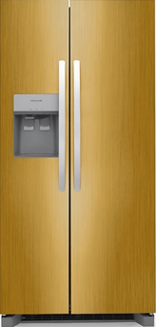
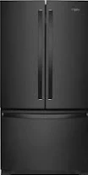
Being Comfortable in the Presence God: God’s Fridge
What’s in God’s Fridge?
What’s in the devils Fridge?
Who’s Fridge do you frequent?
Psalm 23 The Lord is my shepherd; I shall not want.
2 He maketh me to lie down in green pastures: he leadeth me beside the still waters.
3 He restoreth my soul: he leadeth me in the paths of righteousness for his name's sake.
4 Yea, though I walk through the valley of the shadow of death, I will fear no evil: for thou art with me; thy rod and thy staff they comfort me.
5 Thou preparest a table before me in the presence of mine enemies: thou anointest my head with oil; my cup runneth over.
6 Surely goodness and mercy shall follow me all the days of my life: and I will dwell in the house of the Lord for ever.
Shelf #1 – Forgiveness of sins
Shelf #2 – Healing for your body
Shelf #3 – No Condemnation
Shelf #4 – The desires of your heart
Goodness
Mercy
Green Pastures
Path’s of Righteousness
Oil for your head
Stuff that makes your cup run over
The right to dwell in God’s house forever
Shelf #1 – The fruit of the tree in the middle of the garden
Shelf #2 – Enough alcohol to make you drunk
Shelf #3 – Worry
Shelf #4 – Doubt
Fear
Unbelief
Pain
Torment
Destruction
Death

Slide 3
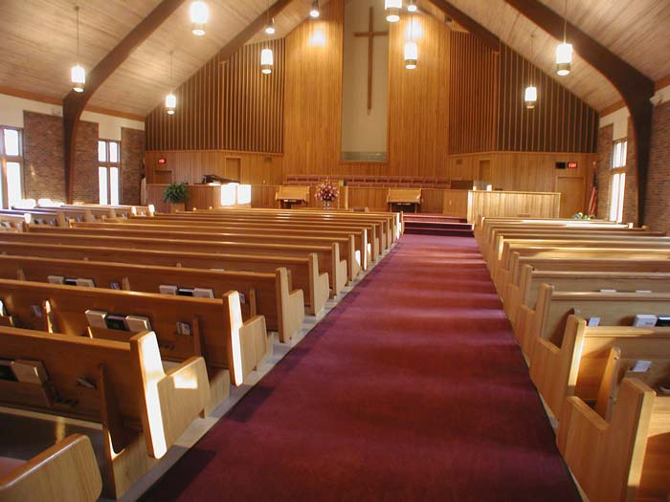

Being Comfortable in the Presence God:
What do we think holiness is?
Someone who never sins
Someone who never thinks about sex
Someone who prays at least 5 hours a day
Someone who goes to church every time the doors are open
No drugs of any kind
No Cussing
God Made us to be Men – but he didn’t make us to sin
James 5:17
Elias was a man subject to like passions as we are, and he prayed earnestly that it might not rain: and it rained not on the earth by the space of three years and six months.
James 5:16
¹⁶ Confess your faults one to another, and pray one for another, that ye may be healed. The effectual fervent prayer of a righteous man availeth much.

Slide 4
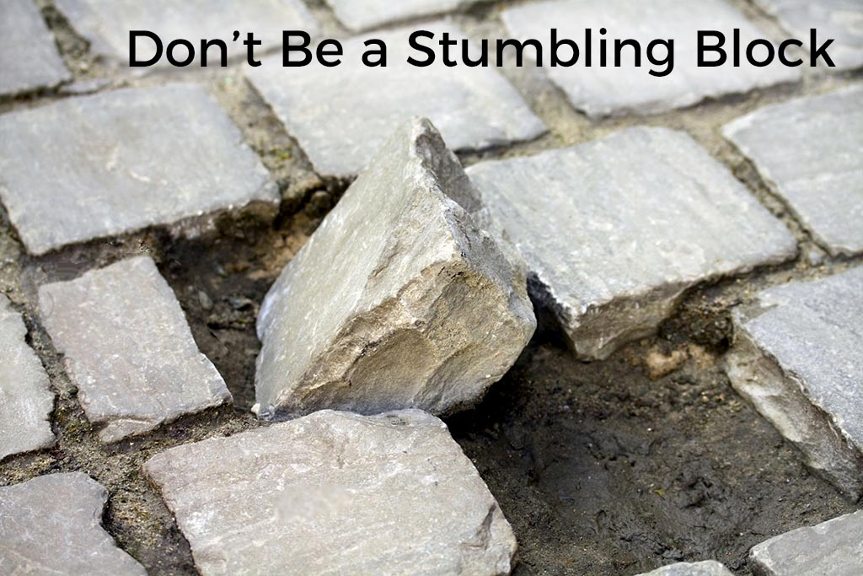
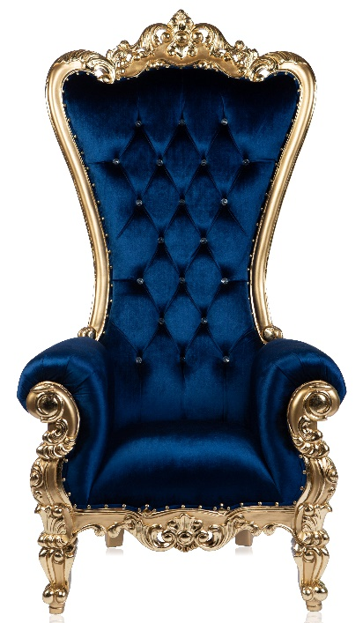
Being Comfortable in the Presence God:
What is biblical holiness?
Don’t be a stumbling block
Romans 14:13
13 Let us not therefore judge one another any more: but judge this rather, that no man put a stumblingblock or an occasion to fall in his brother's way.
How does God perceive your actions?
Ephesians 4:30
30 And grieve not the holy Spirit of God, whereby ye are sealed unto the day of redemption.
Hebrews 4:16 – (What Biblical holiness produces - this)
Let us therefore come boldly unto the throne of grace, that we may obtain mercy, and find grace to help in time of need.

Slide 5
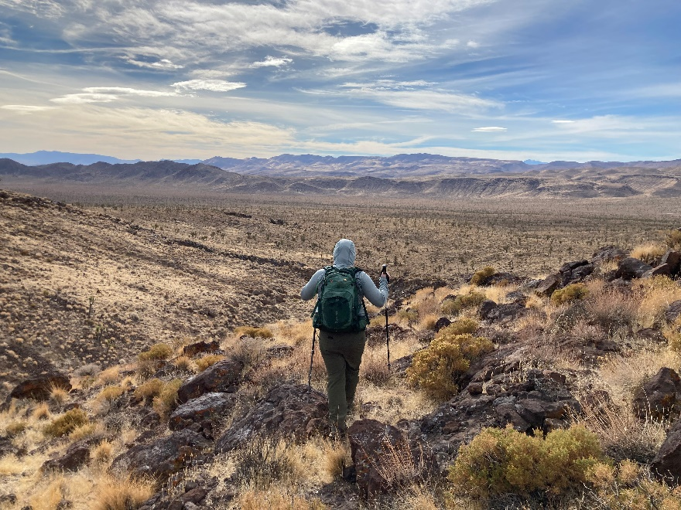
Being Comfortable in the Presence God:
Don’t harden your heart
Callouses of the hands – can keep you safe
Callouses of the heart – are dangerous
Psalms 95:10
10 Forty years long was I grieved with this generation, and said, It is a people that do err in their heart, and they have not known my ways:
Don’t harden your heart
Psalm 95:8
Harden not your heart, as in the provocation, and as in the day of temptation in the wilderness:
The Wilderness
Hebrews 3:15
While it is said, To day if ye will hear his voice, harden not your hearts, as in the provocation.

Slide 6

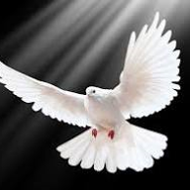
Being Comfortable in the Presence God:
- Let no corrupt communication -
Ephesians 5:18
And be not drunk with wine, wherein is excess; but be filled with the Spirit;
Cussing & Corrupt communication should bother you
Ephesians 4:29-30
Let no corrupt communication proceed out of your mouth, but that which is good to the use of edifying, that it may minister grace unto the hearers.
And grieve not the holy Spirit of God, whereby ye are sealed unto the day of redemption.
Hebrews 3:15
While it is said, To day if ye will hear his voice, harden not your hearts, as in the provocation.
Romans 8:1
There is therefore now no condemnation to them which are in Christ Jesus, who walk not after the flesh, but after the Spirit.

Slide 7
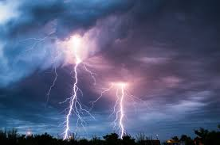
Being Comfortable in the Presence God:
The Sons of Thunder
Mark 3:17
And James the son of Zebedee, and John the brother of James; and he surnamed them Boanerges, which is, The sons of thunder:
(you don’t get this name because you tip toeing around)
…But even being a son of thunder…
We cleanse ourselves from all filthiness
We have been made free from sin
We don’t yield to iniquity
Romans 6:19
I speak after the manner of men because of the infirmity of your flesh: for as ye have yielded your members servants to uncleanness and to iniquity unto iniquity; even so now yield your members servants to righteousness unto holiness.
Romans 6:22
But now being made free from sin, and become servants to God, ye have your fruit unto holiness, and the end everlasting life.
2 Corinthians 7:1 - 7
Having therefore these promises, dearly beloved, let us cleanse ourselves from all filthiness of the flesh and spirit, perfecting holiness in the fear of God.

Slide 8
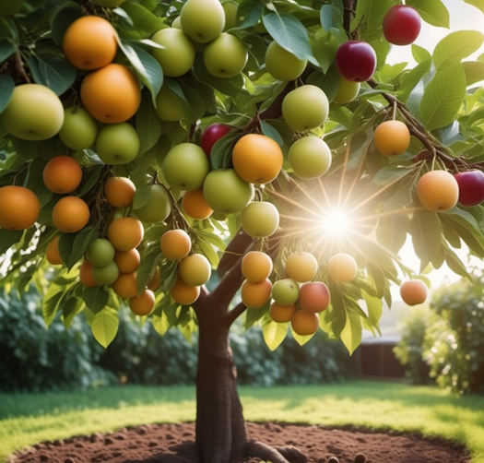
Being Comfortable in the Presence God:
Holiness is hindered by the lust of the eye
Subtil means:
Thin, not dense or gross
Acute, piercing
Sly, artful, cunning, crafty, insinuating
Planned by art, deceitful
Deceitful, treacherous
Refined, fine, acute
Knowing your enemy: Subtil also means slight, delicate, or fine. It can also mean faint or delicate in quality, making it difficult to describe or explain.
Eve has no fear of the serpent – why?
Remember that the Devil tells partial truths
Genesis 3:1-5
3 Now the serpent was more subtil than any beast of the field which the Lord God had made. And he said unto the woman, Yea, hath God said, Ye shall not eat of every tree of the garden?
² And the woman said unto the serpent, We may eat of the fruit of the trees of the garden:
³ But of the fruit of the tree which is in the midst of the garden, God hath said, Ye shall not eat of it, neither shall ye touch it, lest ye die.
⁴ And the serpent said unto the woman, Ye shall not surely die:
⁵ For God doth know that in the day ye eat thereof, then your eyes shall be opened, and ye shall be as gods, knowing good and evil.

Slide 9
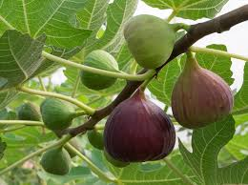
Being Comfortable in the Presence God:
Perhaps a fig tree?
Personal conjecture: I have always thought it was a fig tree – when Jesus said no man eat fruit of you hear after forever, it was like him saying that what happened in the garden of Eden was no longer going to effect mankind anymore – (though I realize he still had to go to the cross)
Knowing your enemy: Subtil also means slight, delicate, or fine. It can also mean faint or delicate in quality, making it difficult to describe or explain.
- Here comes the eyes again -
Genesis 3:6
Eve has no fear of the serpent – why?
⁶ And when the woman saw that the tree was good for food, and that it was pleasant to the eyes, and a tree to be desired to make one wise, she took of the fruit thereof, and did eat, and gave also unto her husband with her; and he did eat.

Slide 10
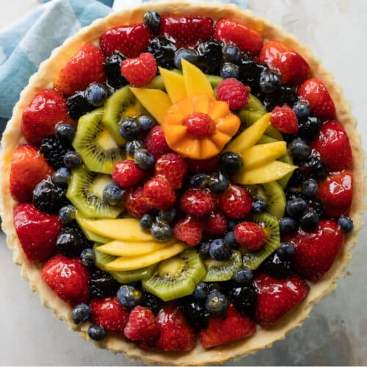




Being Comfortable in the Presence God:
Fruit Pie
I want to do what’s right
But my flesh calls out for more
I reach for the good of looks and feel
To satisfy what my mind thinks I need
But later-on during the upcoming days
The rope gets thinner
And beings to fray
I’m hanging by a thread
Of which I’ve carved my way to dangling
Back and forth the thoughts do race
Playing games with freely given grace
Close to the fire saying
I’ll not get burned
I’ve been here before and I’ve learned
Surely it no longer affects me
Oh how miserable unrighteousness is
The holiness quickly denied
Knowing all too well where the boundary lies
I walk on the edge of the fence
I lean over the side
To snag some of the night
A drink or two couldn’t hurt
I look at the tree
In the middle of the garden
And say this will go in my fruit pie
I ride on the waves of promises
I fully intend to keep
But undermine, the real-truth denied
Negating the principles I speak

Slide 11
Being Comfortable in the Presence God:
ADAM – ADAM – WHERE ARE YOU?
This is knowledge they didn’t need
Adam and even were no longer comfortable in the presence of God
This is the first time they felt fear
God would have explained it to them later
Genesis 3:7-10
⁷ And the eyes of them both were opened, and they knew that they were naked; and they sewed fig leaves together, and made themselves aprons.
⁸ And they heard the voice of the Lord God walking in the garden in the cool of the day: and Adam and his wife hid themselves from the presence of the Lord God amongst the trees of the garden.
⁹ And the Lord God called unto Adam, and said unto him, Where art thou?
¹⁰ And he said, I heard thy voice in the garden, and I was afraid, because I was naked; and I hid myself.

Slide 12
Being Comfortable in the Presence God:
Who told you?
Done been beguiled!
God I’m only human
Got no other reason!
Blame anyone but me!
You’ve been had!
The woman you gave me!
Genesis 3:11-15
¹¹ And he said, Who told thee that thou wast naked? Hast thou eaten of the tree, whereof I commanded thee that thou shouldest not eat?
¹² And the man said, The woman whom thou gavest to be with me, she gave me of the tree, and I did eat.
¹³ And the Lord God said unto the woman, What is this that thou hast done? And the woman said, The serpent beguiled me, and I did eat.
¹⁴ And the Lord God said unto the serpent, Because thou hast done this, thou art cursed above all cattle, and above every beast of the field; upon thy belly shalt thou go, and dust shalt thou eat all the days of thy life:
¹⁵ And I will put enmity between thee and the woman, and between thy seed and her seed; it shall bruise thy head, and thou shalt bruise his heel.

Slide 13
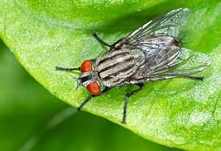
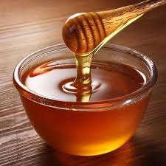
Being Comfortable in the Presence God:
Gave it all up for a moment of pleasure
There was a group of flies – they were out seeking dinner. They had been warned that certain sweet nectars would trap them. As they cruised through the air on their hunt, they saw a plate of honey. Score they shouted – dive in. The group of flies quickly descended on the honey and ate their fill. When they went to fly off, they couldn’t move. They had consumed to much and they were to heavy to fly. It was then they realized, they gave up there whole life for 1 hour of pleasure.
In the case of Adam and Eve, it much less than an hour – perhaps minutes at most. Sin is never worth it. It always make you stay, longer than you want to and it costs more than you want to pay.
Genesis 3:16-20
¹⁶ Unto the woman he said, I will greatly multiply thy sorrow and thy conception; in sorrow thou shalt bring forth children; and thy desire shall be to thy husband, and he shall rule over thee.
¹⁷ And unto Adam he said, Because thou hast hearkened unto the voice of thy wife, and hast eaten of the tree, of which I commanded thee, saying, Thou shalt not eat of it: cursed is the ground for thy sake; in sorrow shalt thou eat of it all the days of thy life;
¹⁸ Thorns also and thistles shall it bring forth to thee; and thou shalt eat the herb of the field;
¹⁹ In the sweat of thy face shalt thou eat bread, till thou return unto the ground; for out of it wast thou taken: for dust thou art, and unto dust shalt thou return.

Slide 14
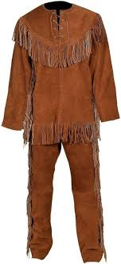
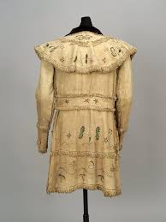
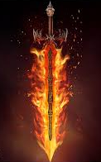
No longer Comfortable in the Presence God:
Locked out of the Garden – Holiness Lost
An act of or a life-style of unholiness will hinder your faith!
Animals had to be sacrificed to make clothes for them when there had been no need for them before
No access to the tree of life
Force to till the ground when it used to produce
The fruit did make them wise; it gave them knowledge they didn’t have, but that knowledge made them realize that they didn’t want the knowledge of good and evil.
All it brought was toil and hardship.
Genesis 3:20-24
²⁰ And Adam called his wife's name Eve; because she was the mother of all living.
²¹ Unto Adam also and to his wife did the Lord God make coats of skins, and clothed them.
²² And the Lord God said, Behold, the man is become as one of us, to know good and evil: and now, lest he put forth his hand, and take also of the tree of life, and eat, and live for ever:
²³ Therefore the Lord God sent him forth from the garden of Eden, to till the ground from whence he was taken.
²⁴ So he drove out the man; and he placed at the east of the garden of Eden Cherubims, and a flaming sword which turned every way, to keep the way of the tree of life.

